Slide 1
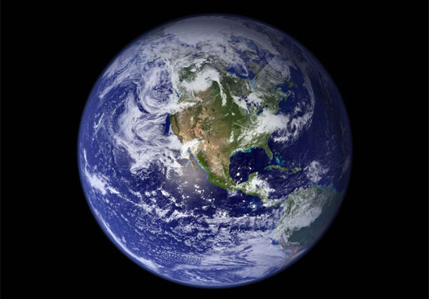
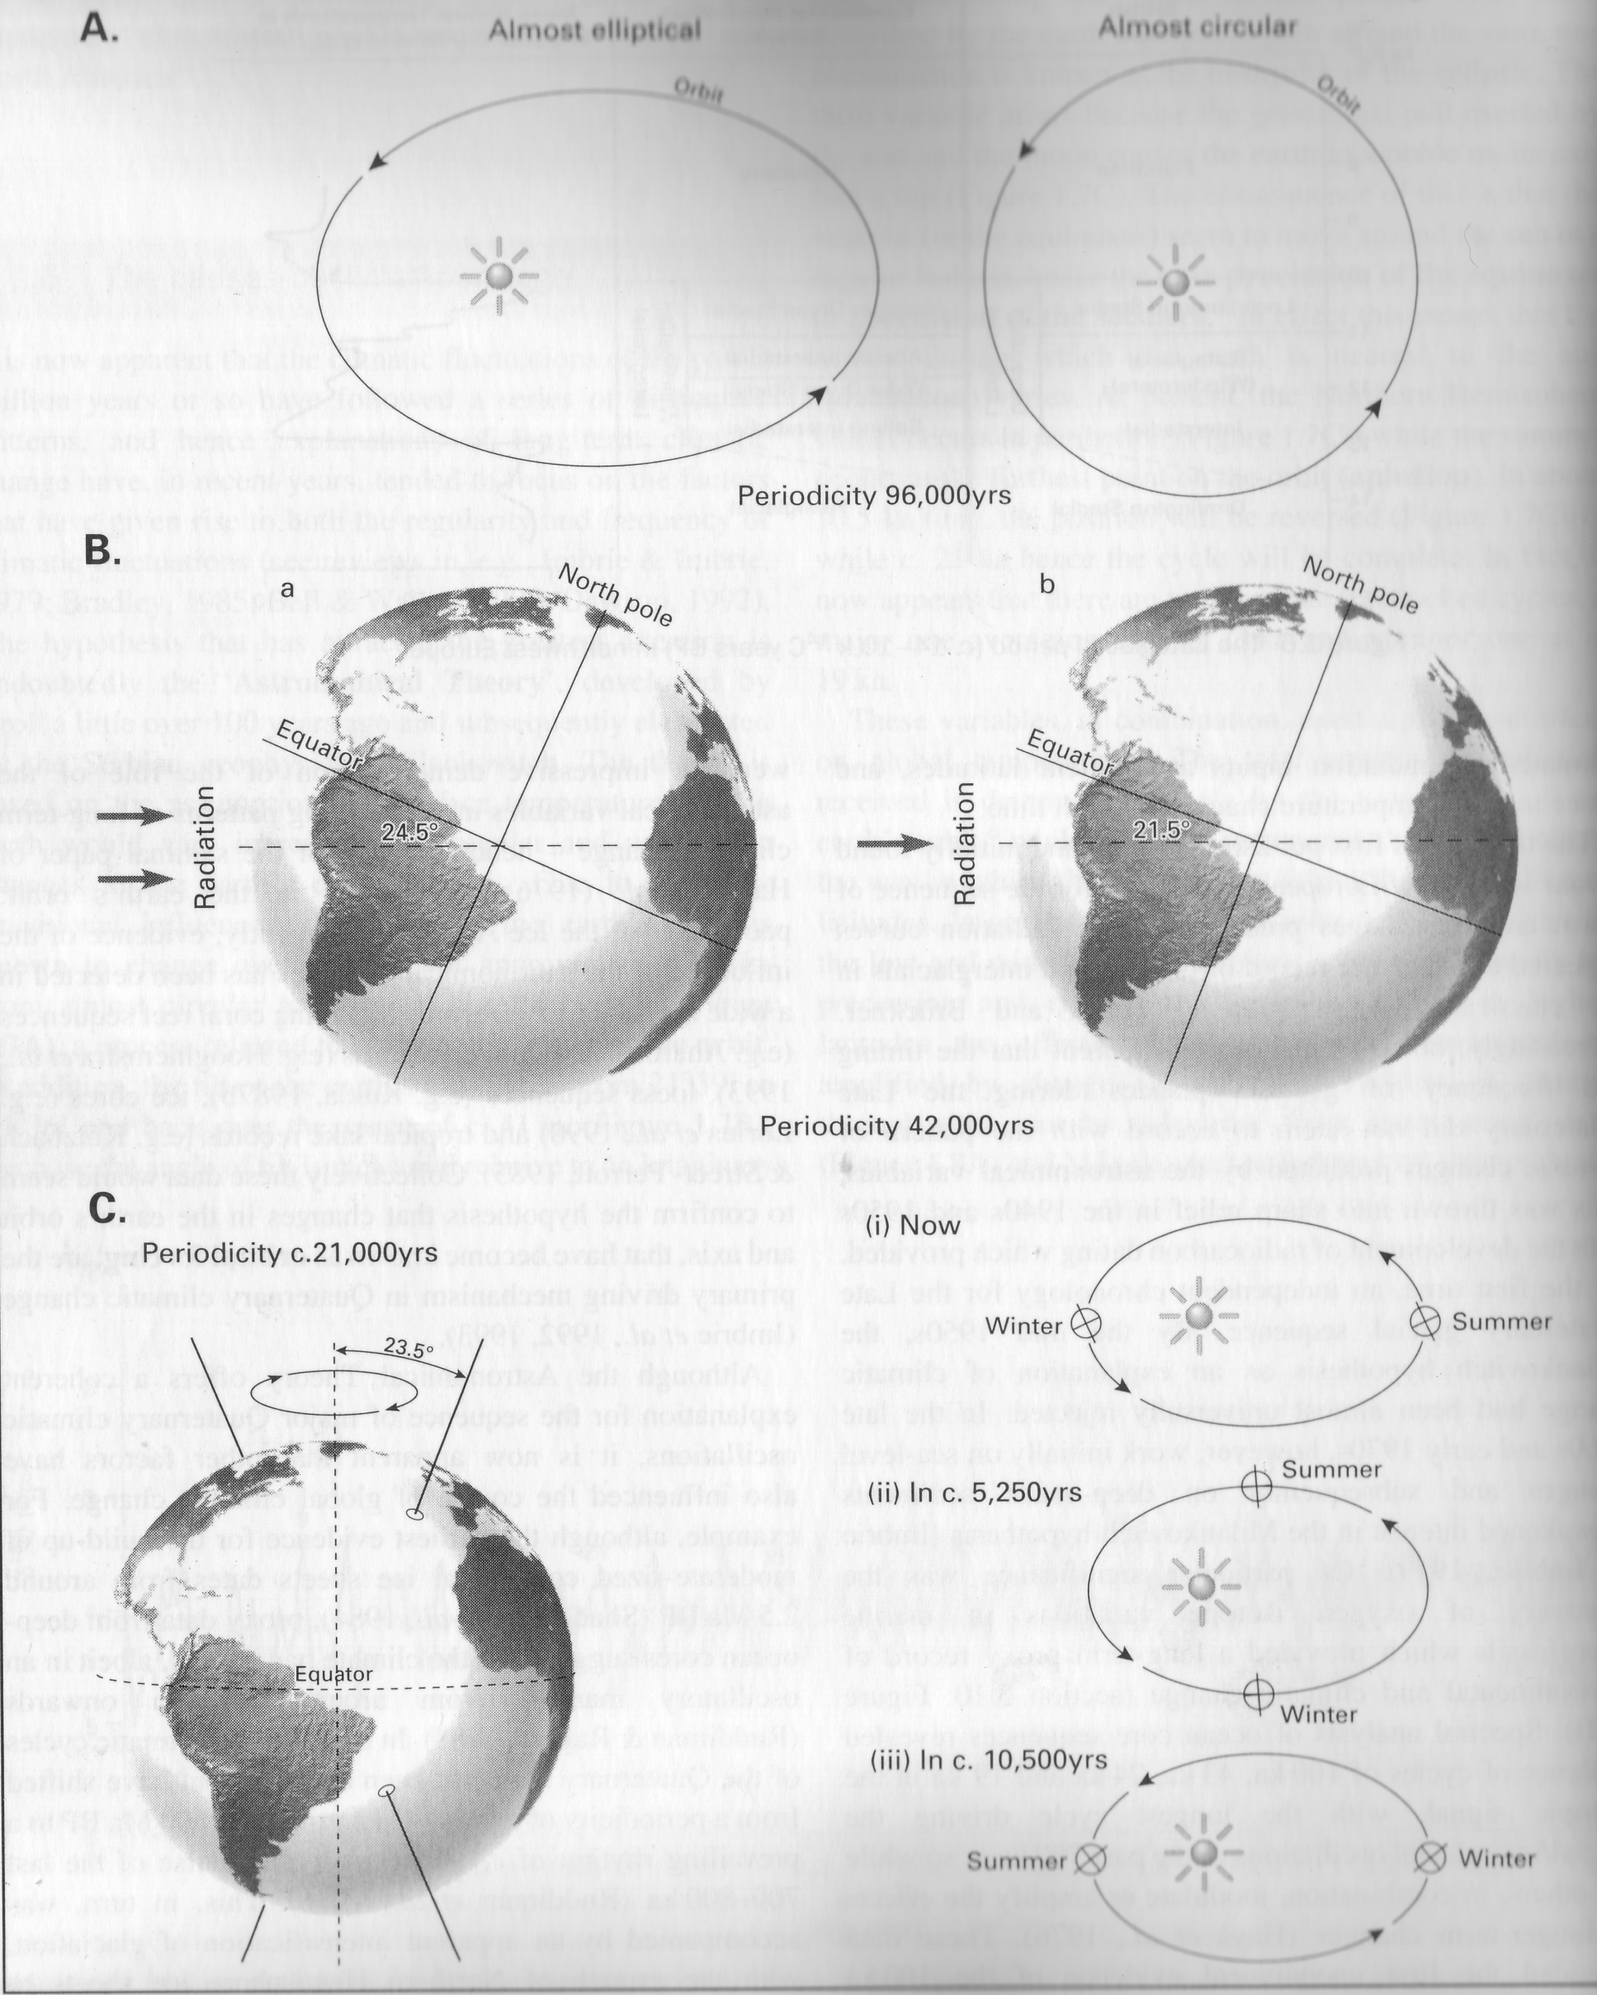
Causes of environmental change
‘Astronomical Theory’ Croll/Milankovitch
Climate fluctuations follow series of distinctive patterns
Theory’ – surface temperature of earth varies in response to changes in earths orbit and axis by three variables:
1. Eccentricity of the orbit – ‘elliptic’
2. Obliquity of the ecliptic – ‘tilt’
3. Precession of the equinoxes – ‘wobble’
Notes:
Suggested by Kroll – developed by Milankovitch – surface temperatures of earth varies according to regular and predictable changes in the earths axis and orbit – prefound effect on global termpes

Slide 2
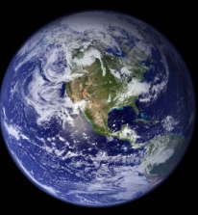
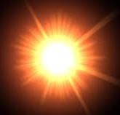
1. Eccentricity of the orbit – ‘elliptic’
Almost circular
Almost elliptical
Periodicity 96 ka

Slide 3
2. Obliquity of the ecliptic – ‘tilt’
21°39’
North Pole
24°36’
North Pole
Equator
Equator
Radiation
Radiation
Periodicity 42 ka

Slide 4
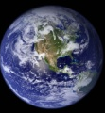
3. Precession of the equinoxes – ‘wobble’
Summer
Gravitational pull of sun and moon –
23.5°
Winter
N
Seasons move around sun season closest = perihelion
Summer
Equator
Winter
Winter
Summer
Periodicity 21 ka
MODEL
Notes:
Gravitational pull from sun and moon causes the earth to wobble on its axis like a top = seasons move around the sun in a regular fashion- seasopn which the earth is closest to sun perihelion varies – poresent n hemi – winter perihelkion summer = amphelion

Slide 5
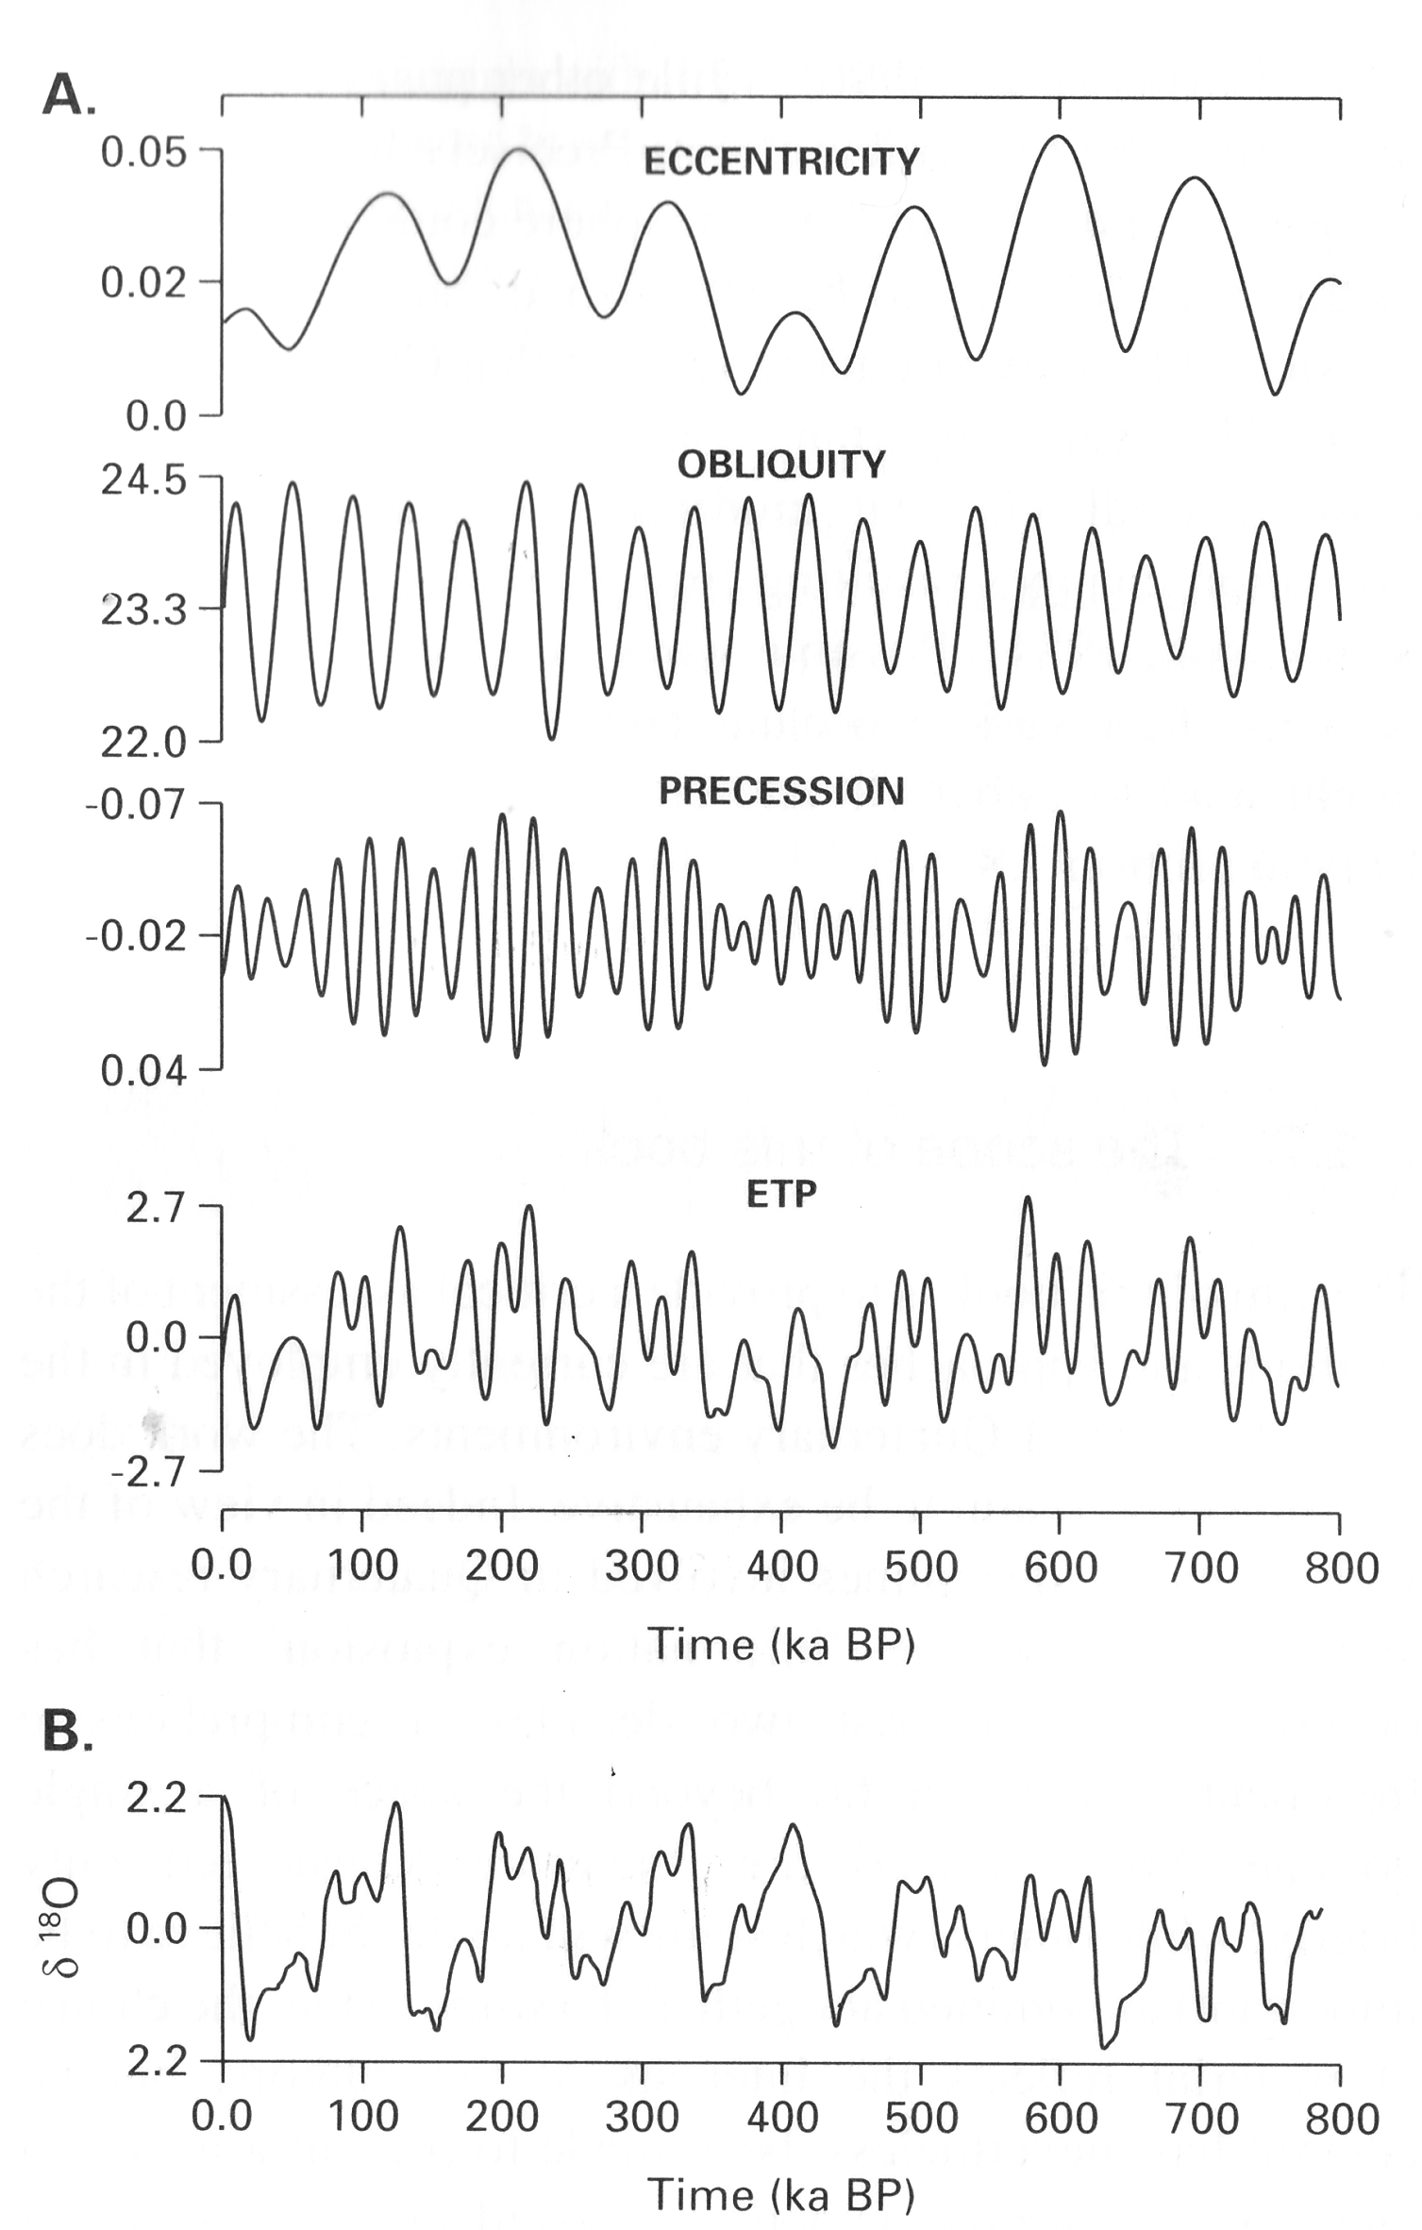
Combined
1
3 variables in combination affect global temperatures
Eccentricity of orbit affects total radiation - wobble and tilt affects heat distribution at different latitudes
Pattern of change calculated from variations predicted from astronomical data
Predictions did not agree with accepted interpretation of glacial stages
Not until discovery of OI record was theory accepted
Ocean cores showed cycles of 100, 43, 24 and 19 ka
Predictions correlated with stratigraphic record
Variables now seen in coral, pollen, loess, ice cores and lake records – called orbital forcing
2
3

